Slide 1


Protozoa Classification Set (from Carolina Biological Supply Company)
Tom Zimmerman
IBM Research-Almaden
Center for Cellular Construction
October 5, 2019
This material is based upon work supported by the NSF under Grant No. DBI-1548297.
Disclaimer: Any opinions, findings and conclusions or recommendations expressed in this material are those of the authors and do not necessarily reflect the views of the National Science Foundation.

Slide 2
Jar File Species Size (um)
=== ==== ======= ========
A UNA unknown A
B UNB unknown B
C UNC unknown C
D SEN Stentor
E ACT Actinosphaerium
F EUP Euplotes
G BUR Paramecium Bursaria
H PAN Pandorina
I EUG Euglena
J PRO Amoeba proteus
K BLE Blepharisma
L PER Peranema
M VUL Arcella Vulgaris

Slide 3
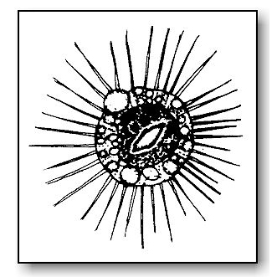
Actinosphaerium
The Actinosphaerium is a protist (protozoan) and belongs to the Phyllum Sarcodina. It looks like a sea urchin and is from 200-1000 micrometers wide. This is quite large for a protist. The image below (left) shows a close up of the endoplasm and ectoplasm, the water expelling vesicles (WEV) and how this protist uses the radial arms to move by flowing the protoplasm into the arms. These are also called Heliozoans, or "Sun Animals". The body is spherical with stiff unbranched arms radiating in all directions.
https://microscope-microscope.org/pond-water-critters-protozoan-guide/sarcodina/actinosphaerium-2/

Slide 4
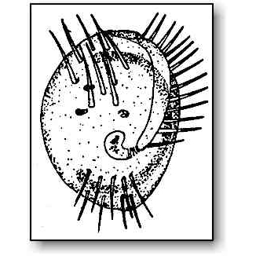
Euplotes
The Euplotes belong to the Phyllum Ciliophora. They are from 80-200 µm long. Euplotes is an interesting ciliate with a transparent body. It has large cilia that is tufted together to form cirri and a band-like macronucleus (the big backward "C" shown inside the body). From the side, Euplotes is quite thin and can be seen using its cirri and "walking" along objects. Below, we see Euplores walking on the edge of an air bubble.
Euplotes are common in fresh water and marine habitats.
.
https://microscope-microscope.org/pond-water-critters-protozoan-guide/ciliophora/euplotes-2/

Slide 5
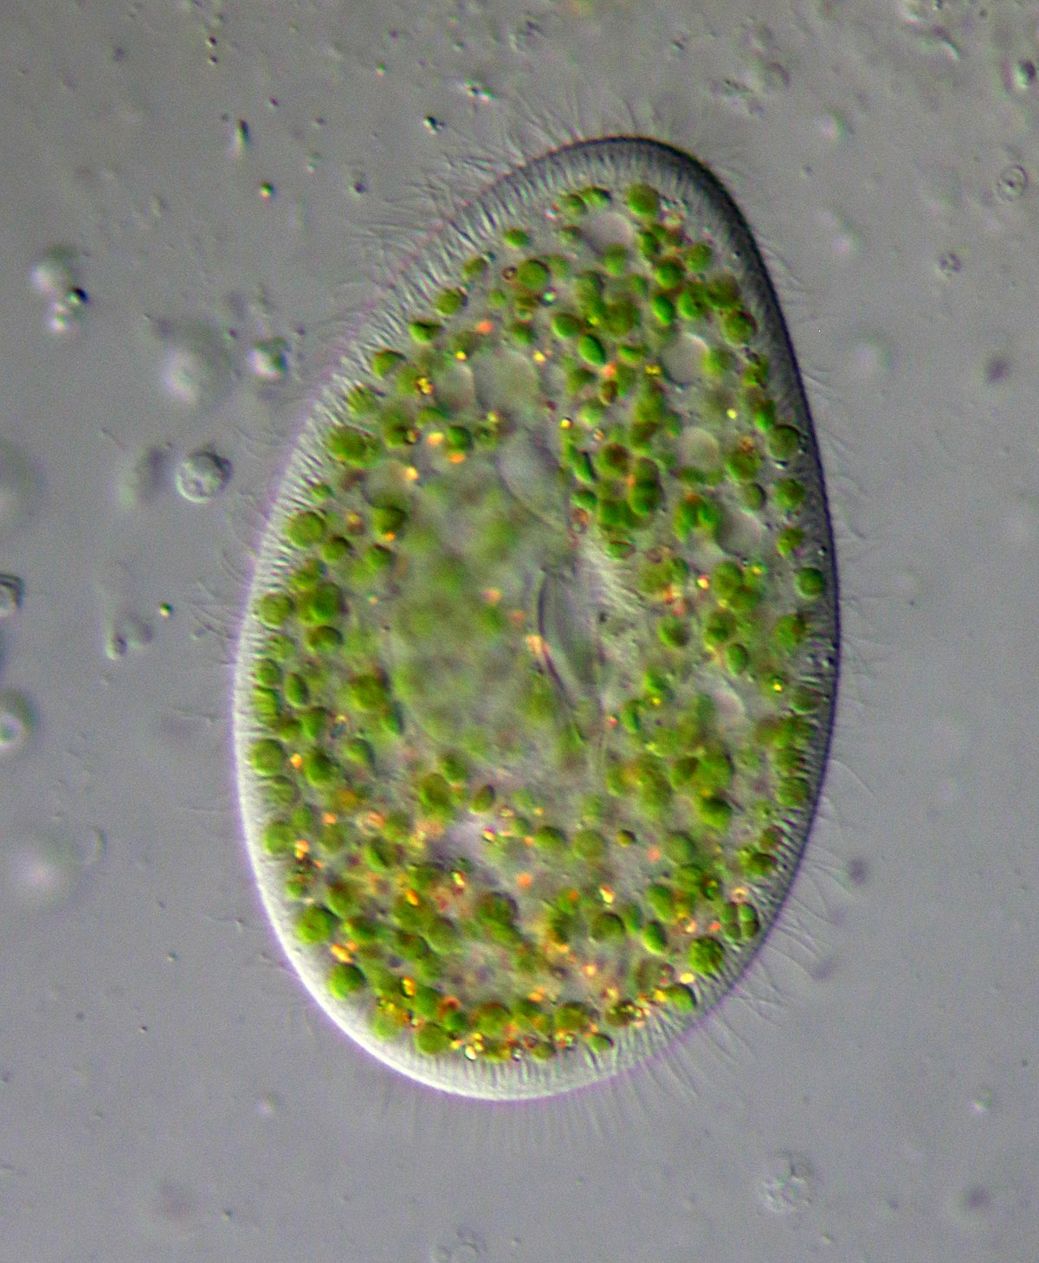
Paramecium bursaria
Paramecium bursaria is a species of ciliate found in marine and brackish waters.[1] It has a mutualistic endosymbiotic relationship with green algae called Zoochlorella. The algae live inside the Paramecium in its cytoplasm and provide it with food, while the Paramecium provides the algae with movement and protection. P. bursaria is 80-150 μm long, with a wide oral groove, two contractile vacuoles, and a single micronucleus as well as a single macronucleus. P. bursaria is the only species of Paramecium that forms symbiotic relationships with algae, and it is often used in biology classrooms both as an example of a protozoan and also as an example of symbiosis.

Slide 6
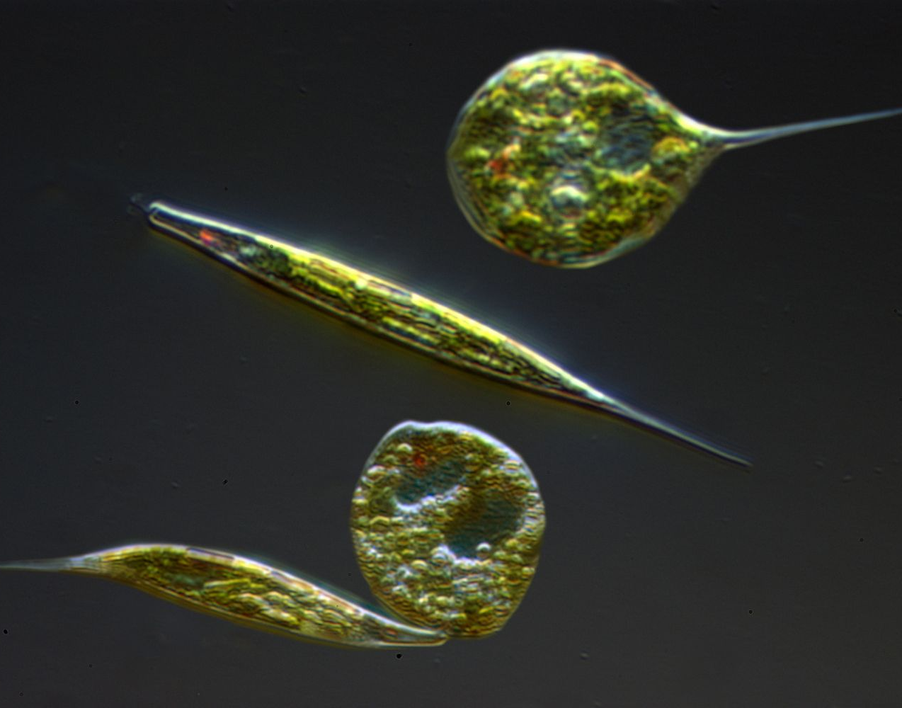
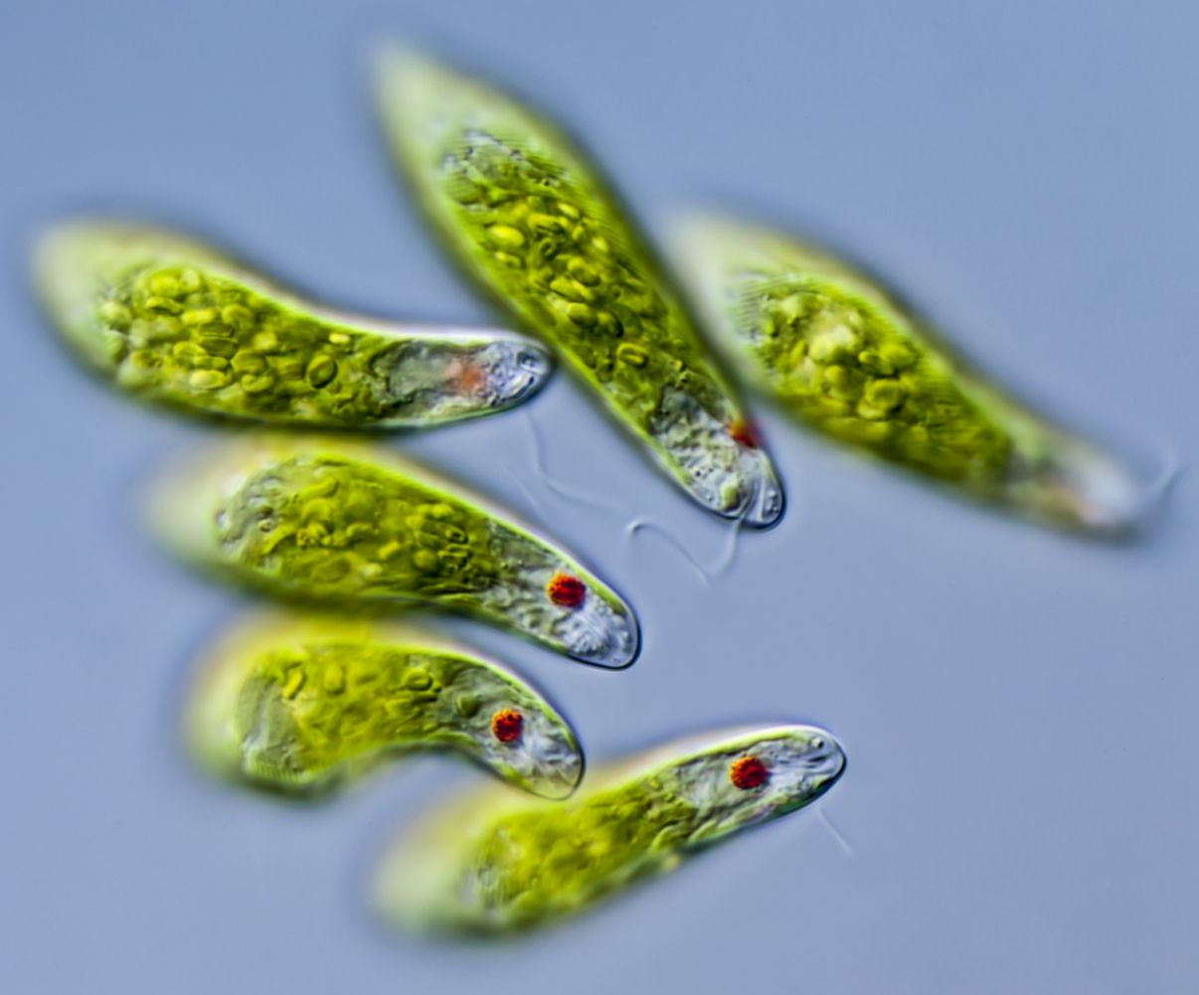
Euglena
Typical size of E. gracilis is 35–50 μm in length and 8–20 μm in diameter. Euglena are tiny protist organisms that are classified in the Eukaryota Domain and the genus Euglena. These single-celled eukaryotes have characteristics of both plant and animal cells. Like plant cells, some species are photoautotrophs (photo-, -auto, -troph) and have the ability to use light to produce nutrients through photosynthesis. Like animal cells, other species are heterotrophs (hetero-, -troph) and acquire nutrition from their environment by feeding on other organisms. There are thousands of species of Euglena that typically live in both fresh and saltwater aquatic environments. Euglena can be found in ponds, lakes, and streams, as well as in waterlogged land areas like marshes.
https://www.thoughtco.com/about-euglena-cells-4099133

Slide 7
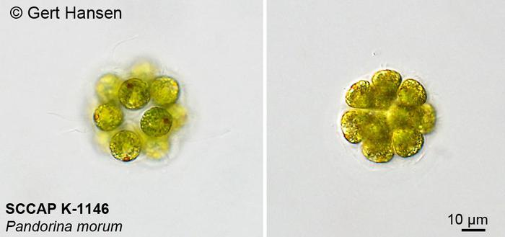
Pandorina
Pandorina is a genus of green algae composed of 8, 16, or sometimes 32 cells, held together at their bases to form a sack globular colony surrounded by mucilage. The cells are ovoid or slightly narrowed at one end to appear keystone- or pear-shaped. Each cell has two flagella with two contractile vacuoles at their base, an eyespot, and a large cup-shaped chloroplast with at least one pyrenoid. A spherical colony is up to 0.5 mm in diameter and contains 2000–4000 small cells.
https://en.wikipedia.org/wiki/Pandorina
http://nordicmicroalgae.org/taxon/Pandorina%20morum

Slide 8
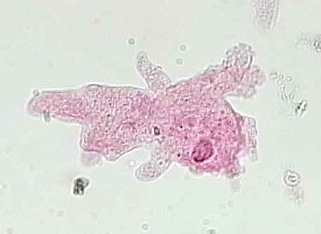
Amoeba proteus
The Amoeba proteus is a large protozoan and belongs to the Phyllum Sarcodina. It has an ever changing shape and is approximately 500-1000µnm long. It can almost be seen with the naked eye.

Slide 9
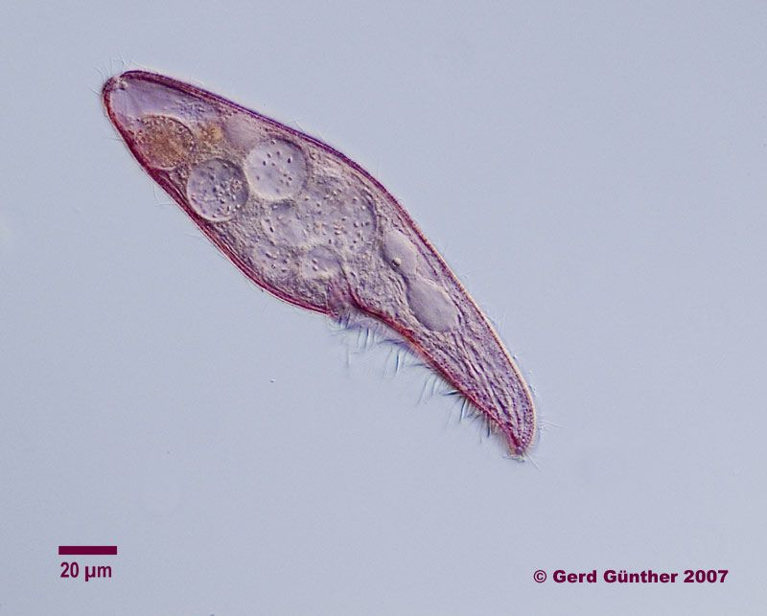
Blepharisma
Blepharisma is a genus of unicellular ciliate protists found in fresh and salt water. The group includes about 40 accepted species, and many sub-varieties and strains. While species vary considerably in size and shape, most are easily identified by their red or pinkish color, which is caused by granules of the pigment blepharismin. Blepharisma may be as small as 50 um in length, or as large as 1 mm (normal size range 75 to 300 um).
https://en.wikipedia.org/wiki/Blepharisma

Slide 10
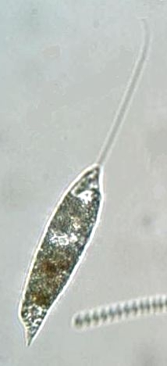
Peranema
Peranema is a genus of free-living phagotrophic euglenids (Euglenida; Euglenozoa; Excavata). There are more than 20 nominal species, varying in size between 8 and 200 um. Peranema cells are gliding flagellates found in freshwater lakes, ponds and ditches, and are often abundant at the bottom of stagnant pools rich in decaying organic material.[2] Although they belong to the class Euglenoidea, and are morphologically similar to the green Euglena, Peranema have no chloroplasts, and do not conduct autotrophy. Instead, they capture live prey, such as yeast, bacteria and other flagellates, consuming them with the help of a rigid feeding apparatus called a "rod-organ." Unlike the green euglenids, they lack both an eyespot (stigma), and the paraflagellar body (photoreceptor) that is normally coupled with that organelle. However, while Peranema lack a localized photoreceptor, they do possess the light-sensitive protein rhodopsin, and respond to changes in light with a characteristic "curling behaviour."

Slide 11
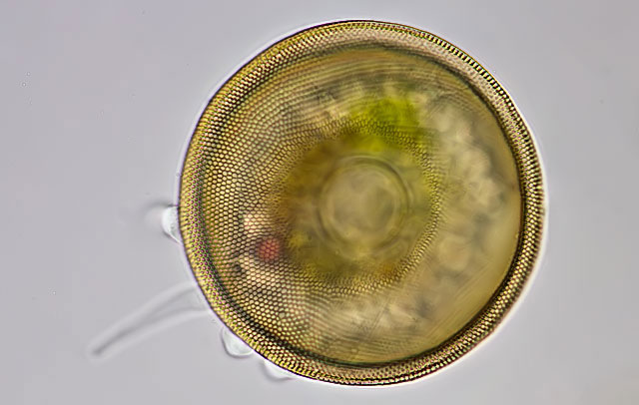
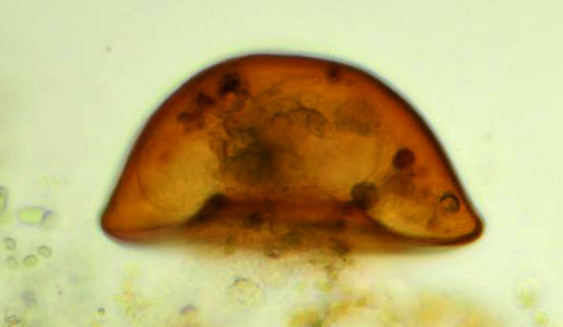
Arcella Vulgaris
Shell hemispherical, a distinct dome, evenly convex, with a distinct basal collar or rim; surface of dome may be undulated; height of test about one-half the diameter; surface smooth or with regular undulations; aperture invaginated, circular, and bordered by small lip; two vesicular nuclei.’
In literature diameter 30-152 µm; diameter of aperture 22-32 µm. However, these measurements may cover a large range of specimens which were considered to be A. vulgaris and are therefore not reliable. My measurements: 80-150 µm, aperture 18-36 µm; ratio diameter of shell – aperture 0.2; ratio diameter – height 1.5-1.8. In the ooze and vegetation in stagnant water and also in soil, among algae and other plants.
https://www.arcella.nl/arcella-vulgaris/

